Slide 1
Network effects in corporate financial policies
William Grieser
Texas Christian University
Charles Hadlock
Michigan State University
James LeSage
Texas State University
Morad Zekhnini
Michigan State University
Journal of Financial Reviews
June 2021
Presented by: Yan Li

Slide 2
Research Question:
What’s the magnitude of peer effects in capital structure ?

Slide 3
Prior Literature
Peer effects in a variety of finance contexts including dividend policy ( Adhikari and Agrawal, 2018; Grennan, 2019 ), stock splits ( Kaustia and Rantala, 2015 ), capital investment ( Dougal et al., 2015; Bustamante and Frésard, 2020; Cookson, 2018 ), corporate social responsibility policies ( Cao et al., 2019 ), and bank liquidity choice ( Silva, 2019 ).
Specific issue of capital structure: strategic considerations in specific industry contexts (see, e.g., Chevalier, 1995; Phillips, 1995; Zingales, 1998 ); the cross-sectional variation in leverage as a function of the product-market environment (see, e.g., MacKay and Phillips, 2005; Almazan and Molina, 2005 ).
Leary and Roberts (2014):A firm’s capital structure as a function of peer average leverage

Slide 4
Data
All accounting and market information is derived from the CRSP-Compustat merged database
Sample period 1996–2017

Slide 5
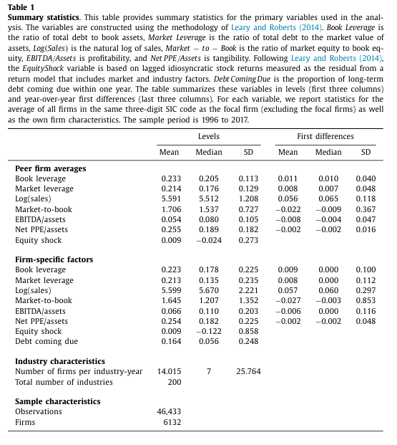
Sample Summary Statistics

Slide 6
Exploiting industry network structure
S_{ij} : Product similarity measure if firm j is a top 10 peer according to product similarity score
Weighted measure: W_{ij} =S_{ij}/the sum of all S_{ij} across j
If there are n firms in year t, the associated n×n weighting matrix with w_{ij} as the entry in row i and column j will be referred as The annual peer-weighting matrix W_{t}
If combine the annual peer-weighting matrices across years to form a block-diagonal matrix (with W_{ijt} denoting the entry in row i , column j, block t), we arrive at an overall sample peer-weighting matrix. This matrix, which we denote by W, will serve as our default/baseline peer network characterization

Slide 7
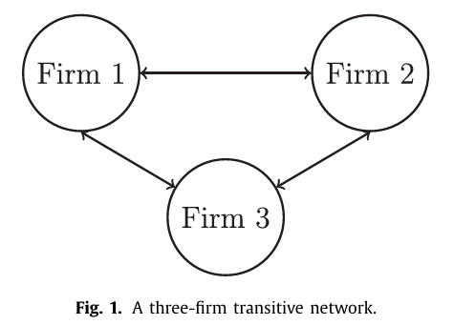

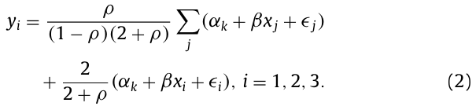

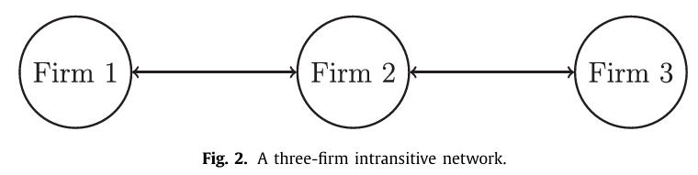
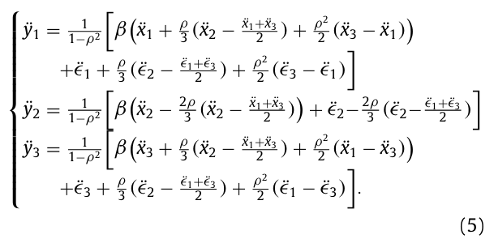
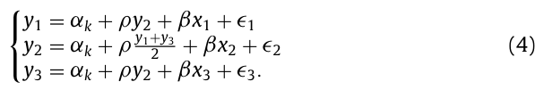
Identification of peer effects
Transitive network case: firms interact in a symmetric manner
Intransitive network case: a lack of symmetry, e.g., one firm is central to the network, and the other two firms only directly interact with this central firm
The use of exogenous variation: Leary and Roberts 2SLS Exogenous variation may initially impact only a peer, but the initial impact will then be transmitted to other firms via the peer effect, and then back to the original firm(s) via the peer of a peer effect. Solve it by combining asymmetries in the peer network structure with exogenous variation

Slide 8
Applying spatial econometrics techniques
Spatial Autoregressive (SAR) model: θ (contextual effects )= 0
ρ: the magnitude of the peer-effect relation
β: the direct role of explanatory variables on a given firm’s dependent variable choice
θ: a vector measuring the role of other firms’ explanatory variables on a given firm’s choice
W: the peer-network weighting matrix characterizing the strength of individual peer interactions
X: a matrix of explanatory variable values, one row corresponding to each firm-year.
Spatial Durbin model (SDM) :

Slide 9
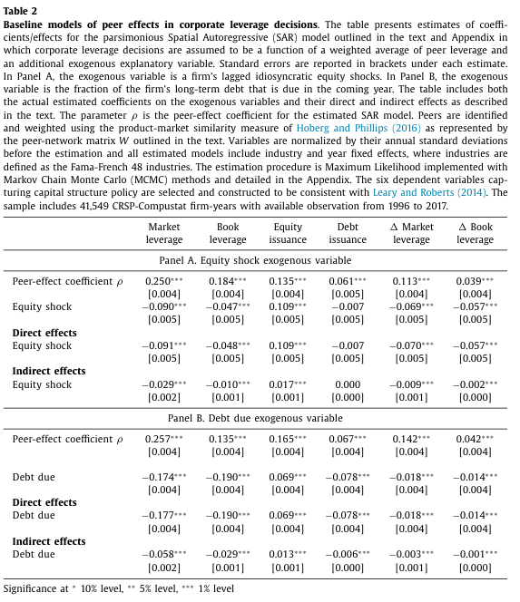
Initial evidence on peer effects
The reported ρ coefficients provide strong evidence of significant peer effects in capital structure decisions.

Slide 10
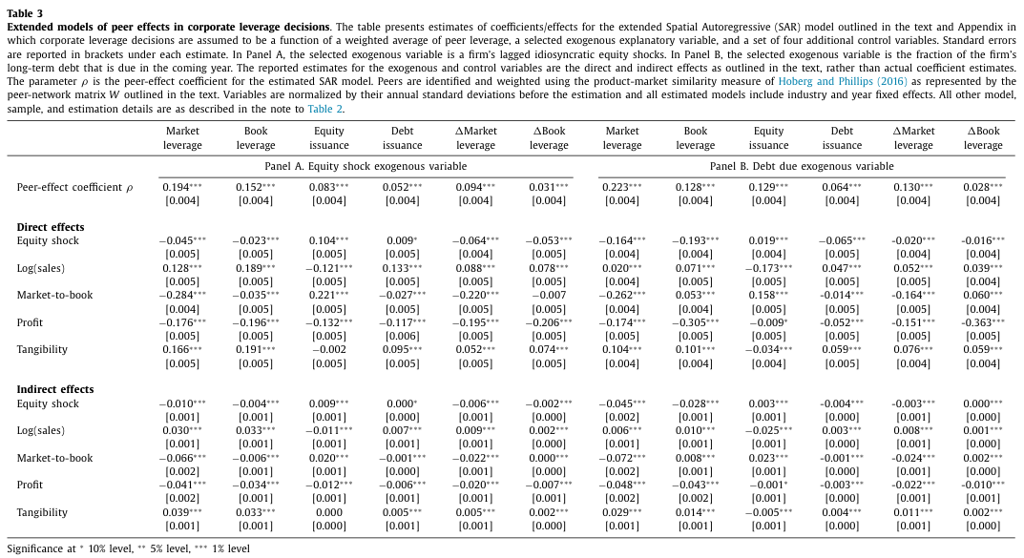
Robustness of initial evidence
The coefficients on the peer-effect parameter ρ are positive and significant in all models, with magnitudes that are comparable to the corresponding earlier estimates.

Slide 11
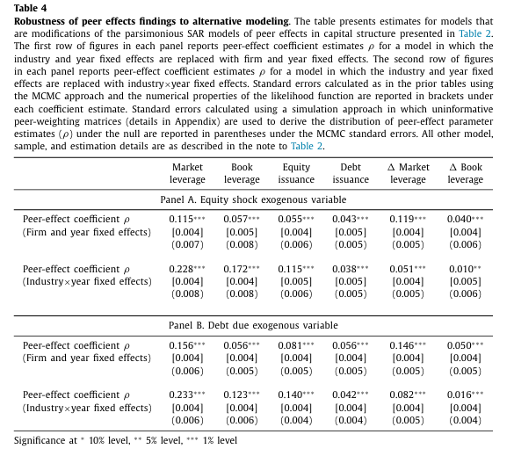
Robustness of initial evidence
The estimated peer-effect coefficients remain positive and highly significant in all models.

Slide 12
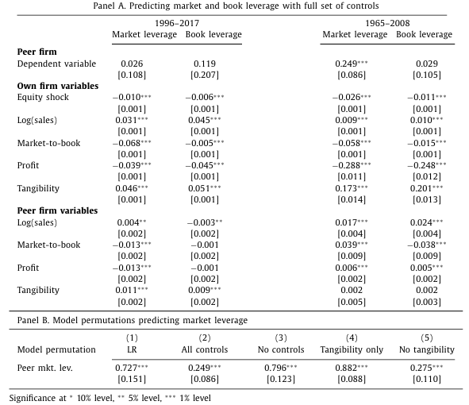
Comparison to evidence from alternative estimation approaches
Table 5 Peer-coefficient estimates from traditional 2SLS models . This table presents 2SLS estimates predicting firms’ leverage levels as a function of peer average leverage and control variables. Peer average leverage is instrumented using the average equity shock of a firm’s industry peers and the peer set is defined based on common 3-digit SIC codes. Coefficient estimates from the second stage are reported in the table with standard errors under the coefficient estimates.
Leary and Roberts: reported effect is at least 3.5 to 5 times larger than what is implied by our estimates and suggests that peer leverage is a dominant factor in causally determining a firm’s leverage policy
Column1-2: the 2SLS coefficients we estimate on peer (unweighted) average leverage, reported in the first row, agree with LR in sign, but they are small and insignificant.
Columns 3–4, the estimated peer-effects coefficients are somewhat different for the earlier period, and the coefficient in the market leverage model is now significant but substantially smaller than the corresponding LR figure.

Slide 13
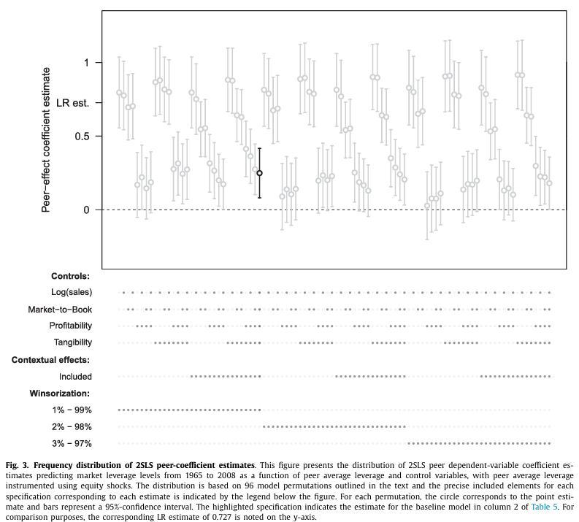
Comparison to evidence from alternative estimation approaches
3 × 16 × 2 = 96 model permutations
Relatively small variations in modeling choices result in a set of estimates that vary widely, from close to 0 to more than 0.90. The dispersion in these figures suggests that 2SLS estimates of purported peer-effect coefficients are quite unstable, in addition to being theoretically ambiguous indicators of the underlying quantity of interest.

Slide 14
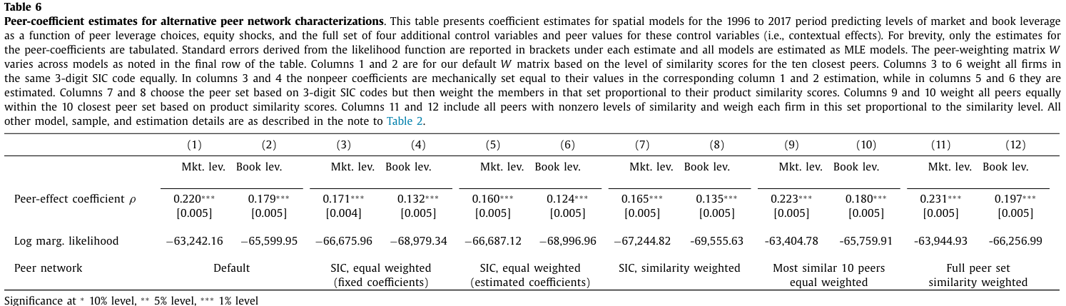
Evidence on the role of the peer-network characterization
log-marginal likelihood (LML) values: assess model fit. Larger (i.e., less negative) figures provide evidence of better model fit.
Important information content is gained when the members of the peer network are selected based on product similarity scores rather than SIC codes. More important element in the peer network characterization is in the selection of peers, rather than in the precise weights. Inclusion of distant peers does not lead to an improvement that would merit their inclusion.
The baseline models indicate a significant peer role in leverage decisions with an initial effect on the order of 0.20 that is slightly magnified as the firm and peer network re-equilibrate.

Slide 15
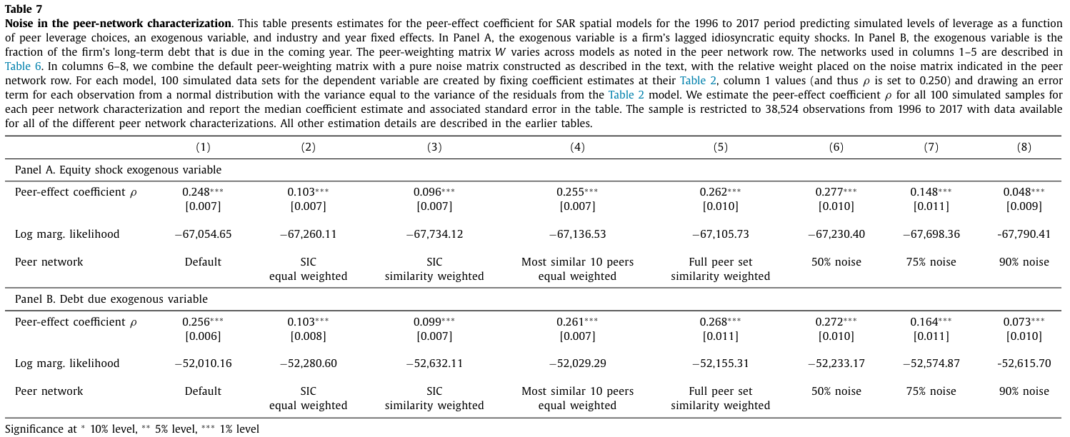
Measurement error in the peer network
25%/75% level : significant downward bias; a 10%/90% noise ratio: the coefficient approaches to 0

Slide 16
Table 6 & 7 Takeaway
The magnitudes of estimated peer-effect coefficients using the framework are not highly sensitive to a reasonable degree of noise in the matrix characterizing peer interactions.
There is a significant difference between using SIC codes and product similarity scores as the starting point for characterizing peer interactions. The latter choice will generally lead to more economically informative estimates.

Slide 17
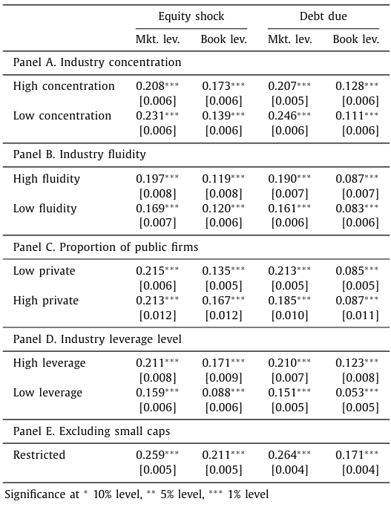
Variation across subsamples
Table 8 Peer-effect coefficient estimates by subsample. This table presents sub- sample estimates of the peer-effect coefficients ρ from the parsimonious SAR models of Table 2 in which corporate leverage levels are a function of peer leverage and an exogenous explanatory variable.
There are some modest but no compelling differences in peer-effect coefficients ρ estimated for more versus less concentrated industries, or in a more versus less fluid product- market environment, or public versus private firms.
Estimated peer- effect coefficients in the market (book) leverage models are approximately 25% (100%) larger for with above median leverage compared to firms in below median industries.
Panel E: small firms do not treat leverage as a strategic choice variable in the context of product-market interactions. Excluding small caps, the magnitude of estimated peer effects rises by a modest amount

Slide 18
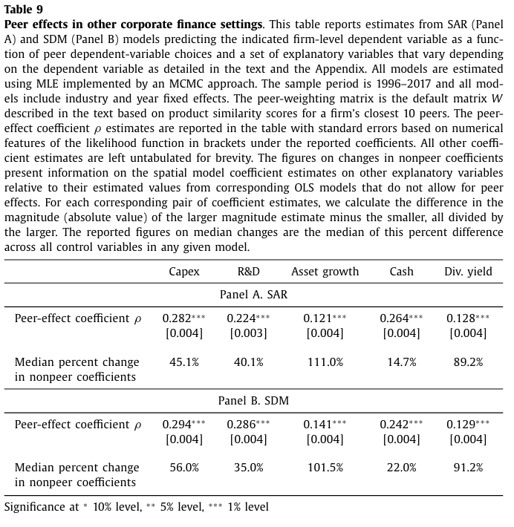
Peer effects in other finance contexts
All of the estimated ρ coefficients are positive, substantial in magnitude, and highly significant.

Slide 19
Conclusions
There’re strong positive peer effects in capital structure decisions. The initial sensitivity of a firm’s leverage choice to a similarity-weighted measure of peer average leverage is on the order of 0.20.
The detected behavior reflects strategic considerations, and variation in the magnitude of estimated peer effects across different product-market environments.
There are significant peer effects for several other important firm policies. Peer effects must be accounted for to uncover an accurate picture of firm financial behavior

Slide 20
Thank you!

